Slide 1
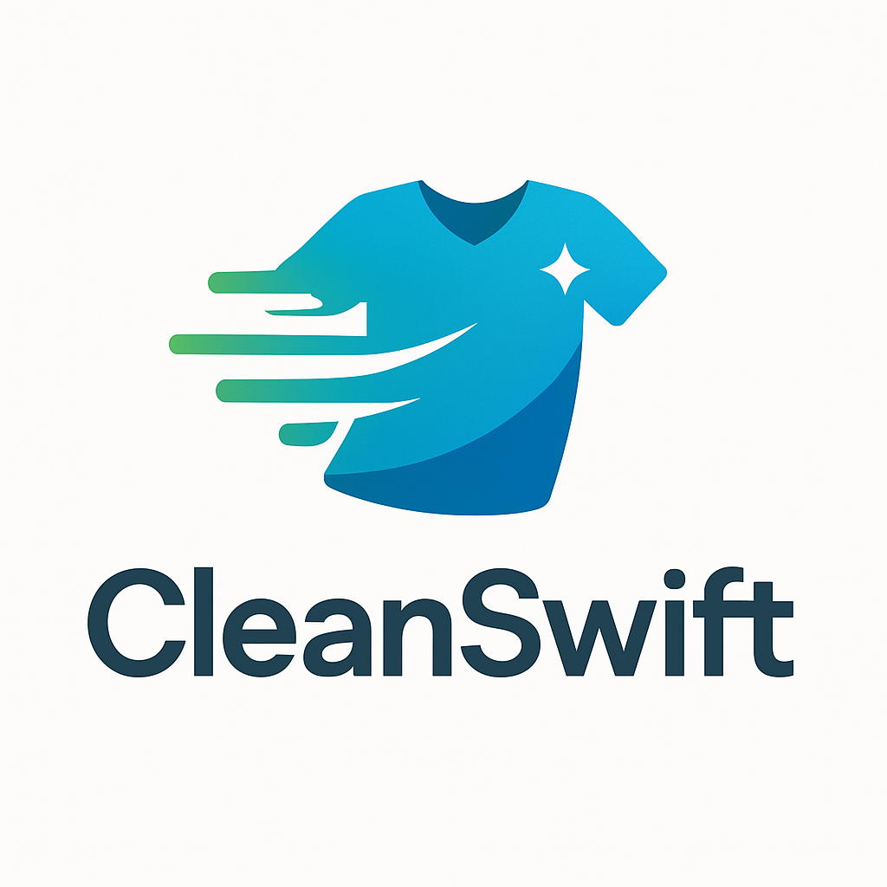
CleanSwift Laundry App
Marketing Plan
Presented by: Heba Saayda
E-commerce Major, Khadouri University
Course: Electronic Marketing
Instructor: Shaima Bowaghni

Slide 2
Executive Summary
Innovative laundry and ironing service app for Tulkarm, Palestine
Addresses the needs of busy professionals, families, and students
Comprehensive service: pickup, washing, ironing, delivery
User-friendly mobile app for ordering, tracking, and payment
Differentiated by convenience, quality, and technology
Local operations model to address transportation challenges
Clear marketing objectives and implementation strategy

Slide 3
Mission & Resources
Mission Statement:
To simplify the lives of busy individuals and families by providing a convenient, reliable, and high-quality laundry and ironing service accessible through an easy-to-use mobile application.
Key Resources:
Technological: Mobile app for iOS and Android platforms
Human: Skilled laundry professionals and delivery drivers
Physical: Local laundry facilities with industrial equipment
Financial: Initial funding for development and operations

Slide 4
Services Offered
Service | Description | Pricing Mechanism | Key Benefit
Wash & Fold | Washing, drying, and folding everyday clothes with high quality | Per kilogram / Per bag | Time and effort saving
Professional Ironing | Carefully ironing clothes to ensure they are wrinkle-free | Per piece / Per hour | Ready-to-wear clothes
Dry Cleaning | Specialized cleaning for delicate clothes (via partners) | Per piece | Preservation of delicate items
App Features | Easy ordering, tracking, payment, preference customization | Included in service | Convenience and control

Slide 5
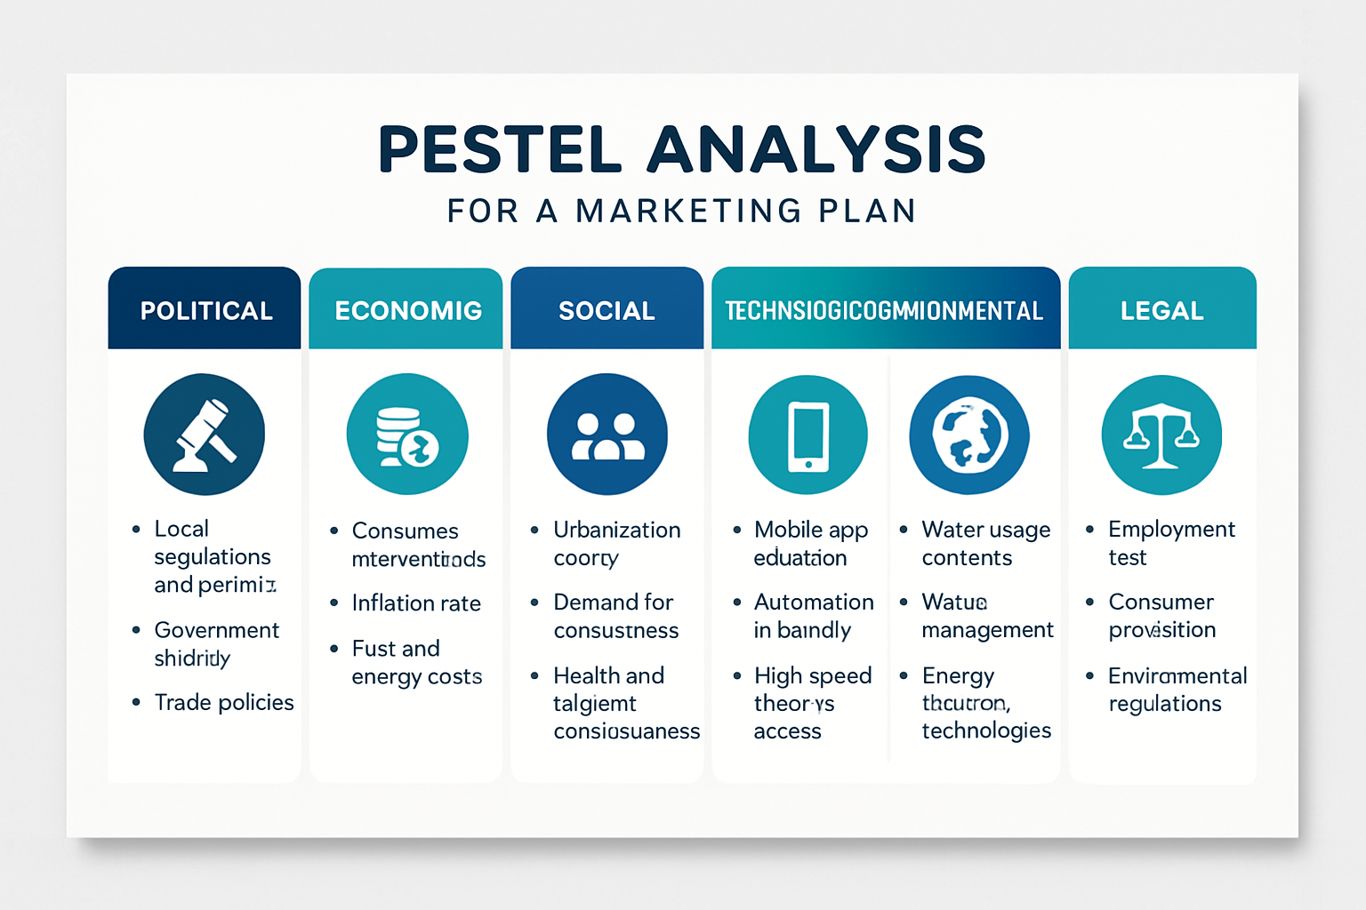
PESTEL Analysis
Political: Local business regulations, labor laws, data privacy laws
Economic: Disposable income, economic growth, inflation, consumer spending
Social: Busy lifestyles, attitudes toward outsourcing, technology adoption
Technological: Smartphone penetration, internet reliability, payment systems
Environmental: Water/energy consumption, eco-friendly detergents, carbon footprint
Legal: Consumer protection laws, health & safety regulations, licensing

Slide 6
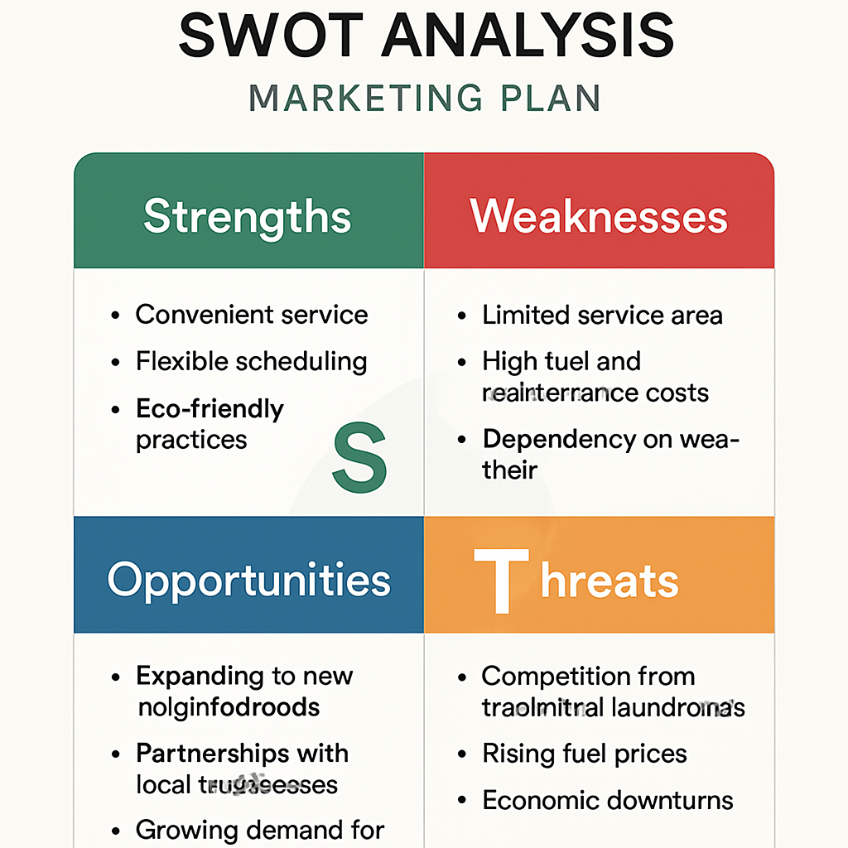
SWOT Analysis

Slide 7
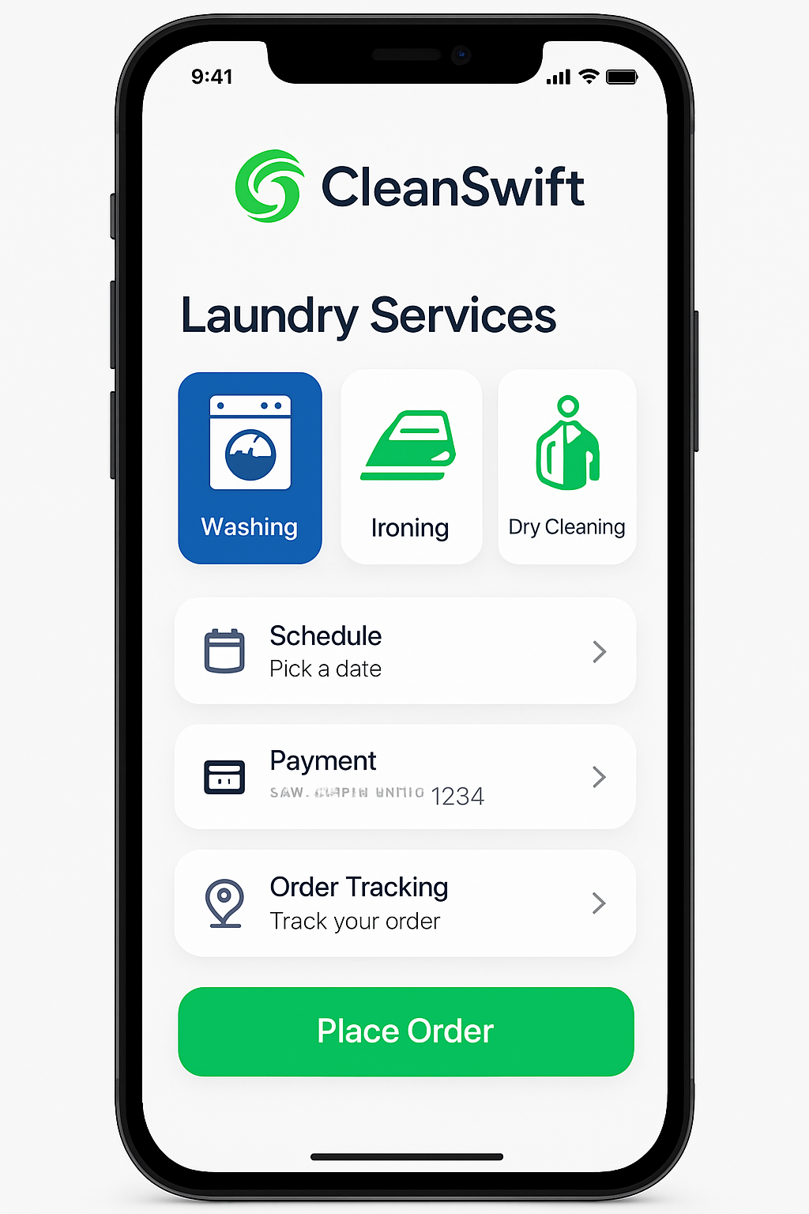
Target Market
Primary Market Segments:
1. Busy Professionals & Dual-Income Families
Age: 25-50 years
Income: Medium to high
Characteristics: Value time, busy schedules, quality-conscious
Key message: "Reclaim your time, we'll handle your laundry"
2. Students & Young Independents
Age: 18-25 years
Characteristics: Tech-savvy, convenience-oriented, price-sensitive
Key message: "Your laundry made easy with just a tap"

Slide 8
Marketing Objectives
Market Objectives:
Acquire 500 active customers within 6 months
Achieve 20% brand recall within one year
Establish operations in all neighborhoods of Tulkarm
Financial Objectives:
Reach break-even within 12-18 months
Increase average order value by 10% in first year
Achieve 15% profit margin by end of second year
Operational Objectives:
Maintain 48-hour average delivery time
Achieve 98%+ order accuracy rate
Attain 4.5+ star average customer rating

Slide 9
Marketing Strategy
Competitive Strategy: Focused Differentiation
We will focus on specific market segments in Tulkarm with a differentiated service offering that emphasizes convenience, quality, and technology.
Growth Strategy: Market Penetration & Development
Phase 1: Establish strong presence in Tulkarm
Phase 2: Expand to nearby cities with local operations centers
Phase 3: Introduce additional services (alterations, specialty cleaning)
Key Differentiators:
Unparalleled convenience through app-based service
High reliability and quality standards
Local focus (operations centers in each city)
User-friendly technology

Slide 10
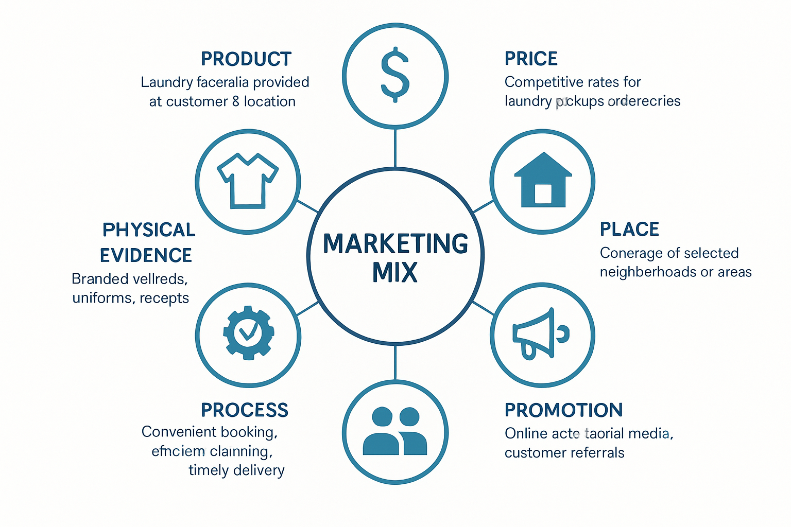
Marketing Mix (7Ps)

Slide 11
Metrics & Implementation
Key Performance Indicators (KPIs):
App downloads and registrations
Customer conversion rate
Average order value
Order frequency
Customer ratings and satisfaction
Implementation Timeline:
Month 1-2: App development and testing
Month 2-3: Establish operations center and partnerships
Month 3: Launch marketing campaign
Month 4: Official service launch in Tulkarm
Month 6: Evaluation and strategy refinement
Month 12: Begin expansion planning to additional cities

Slide 12
Conclusion
CleanSwift provides an innovative solution to meet the laundry needs in Tulkarm:
Addresses clear market need for convenient, high-quality laundry services
Combines technology and service excellence
Focused strategy with clear objectives and implementation plan
Local operations model addresses transportation challenges
Comprehensive marketing mix to drive customer acquisition and retention
Scalable business model with potential for expansion
Thank You!

